Slide 1
Incident Reports
Support Team

Slide 2
Sembawang Office wireless router problem
2010/08/13 09:30 - 10:45
Wireless router wouldn't connect to the Internet
Internet connection disappeared after ISP switch. But, connection using IP address only was fine.
DNS Configuration error
The DNS settings were still pointed toward the old ISP. The integrator forgot to change them to the new ISP DNS servers.

Slide 3
Fixing Printer at Woodlands Branch Office
2010/08/03 13:30 - 15:05
Laserjet P1005 doesn't print
The printer attached to the receptionist desk is not printing since yesterday.
Clear the printer queue
The printer queue was stuck with the previous job. I had to delete the print queue, restart the Windows 7 machine attached to the printer.

Slide 4
Core Web Servers down
2010/09/28 19:30 - 23:05
Web servers became inaccessible after configuration changes
The web server went down due to misconfiguration in the Apache config. Some supporting libraries were also missing in the Linux machines that host the web server.
Reinstall Linux and reconfigure Apache
The integrator was inexperience with Linux, and the deployment of Apcahe config was done without proper checking and testing. It took about 1 hour to pinpoint the config error, and the web servers were inaccesible during that period.

Slide 5
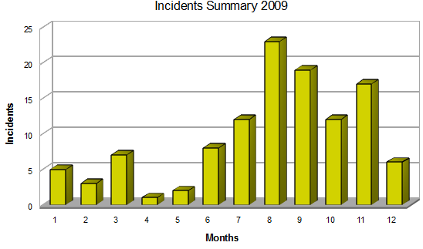
2009 Incident Chart

